Slide 1
Materials and Light maps
Lecturer : Tanaboon Tongbuasirilai
Course : ICCS404
Week 6 : Light and color

Slide 2

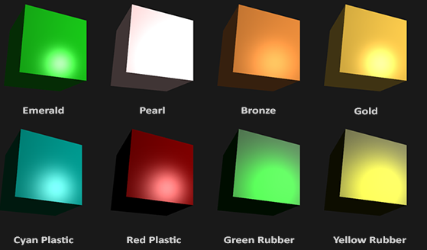
Simulating a range of materials
Notes:
Each one looks unique but they have core properties which define how light interacts with.

Slide 3
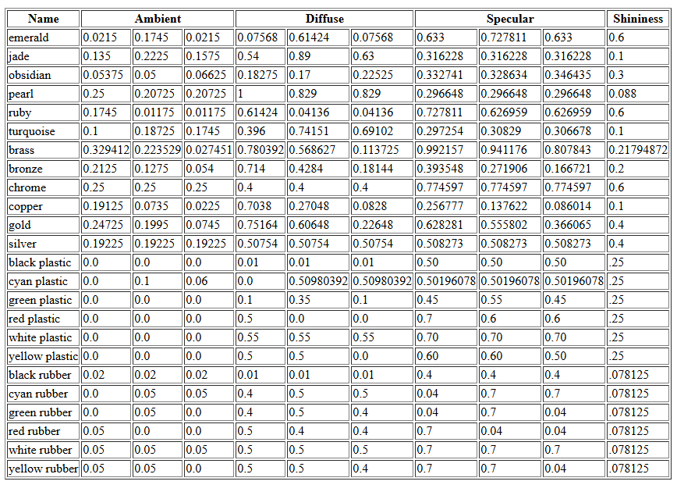
http://devernay.free.fr/cours/opengl/materials.html

Slide 4
Material properties
Material Struct
A struct is used to organize the material properties of a surface, keeping the shader code more manageable than using individual uniform values.
Phong Lighting Components
Ambient Material Vector - Defines the color the surface reflects under ambient lighting, usually the same as the surface color.
Diffuse Material Vector - Defines the color of the surface under diffuse lighting, typically set to the surface color.
Specular Material Vector - Sets the color of specular highlights, potentially reflecting a specific surface color.
Shininess
Controls the scattering and size of the specular highlight on the surface.

Slide 5
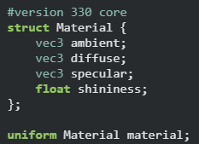
A material struct
Notes:
GLSL can have struct declared.

Slide 6
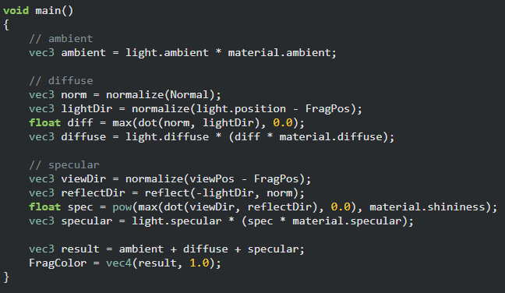
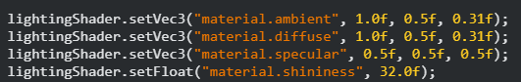
Coloring objects with reflections
Do not forget to set these values from the core application.
Notes:
Previously, we learned how to colorize an object by blending different reflection behaviors.
Ambient
Diffuse
Specular
Defining a material struct helps us grouping require properties in a single unit.

Slide 7
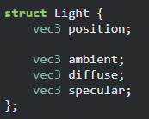
A light struct
Notes:
Light can be defined as an object with lighting is a kind of material.

Slide 8
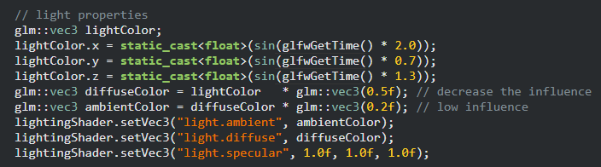
Simple animation: Light dancing
Notes:
You can make use of animation to change light properties during rendering loop.

Slide 9
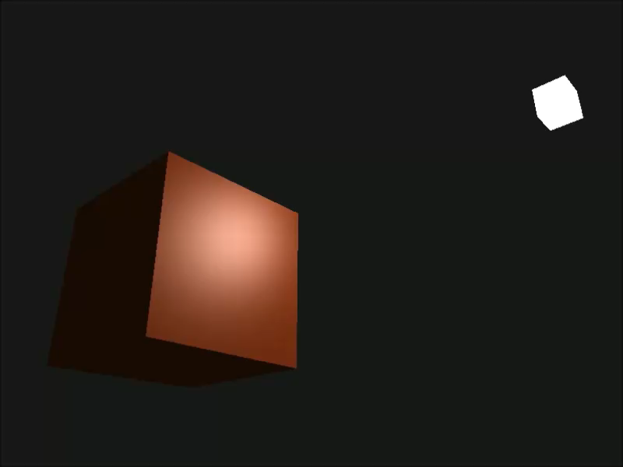
Result

Slide 10
Material appearance

Slide 11
Keys to enhance realism
1. Physically Based Rendering (PBR)
2. Global Illumination (GI)
3. Ambient Occlusion
4. High-Resolution Textures & Normal Maps
5. Subsurface Scattering (SSS)
6. Accurate Shadows
7. Depth of Field
8. Motion Blur
9. Anti-Aliasing
10. Reflection & Refraction
11. Volumetric Lighting & Fog
12. Anisotropic Filtering
13. HDR Lighting & Tone Mapping
14. Correct Use of Light Sources
15. Post-Processing Effects
16. Realistic Animation
Notes:
From chatgpt

Slide 12
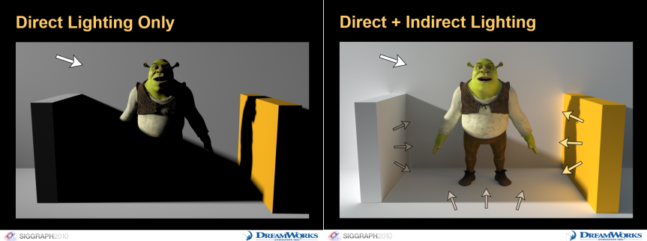
Global illumination
https://colinbarrebrisebois.com/2015/11/06/finding-next-gen-part-i-the-need-for-robust-and-fast-global-illumination-in-games/

Slide 13
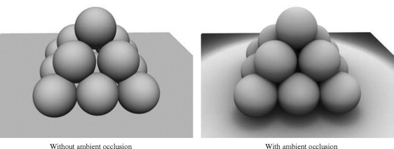
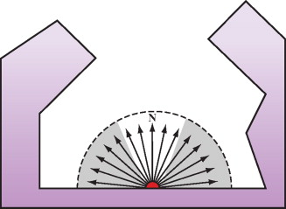
Ambient occlusion
https://www.sciencedirect.com/topics/computer-science/ambient-occlusion

Slide 14
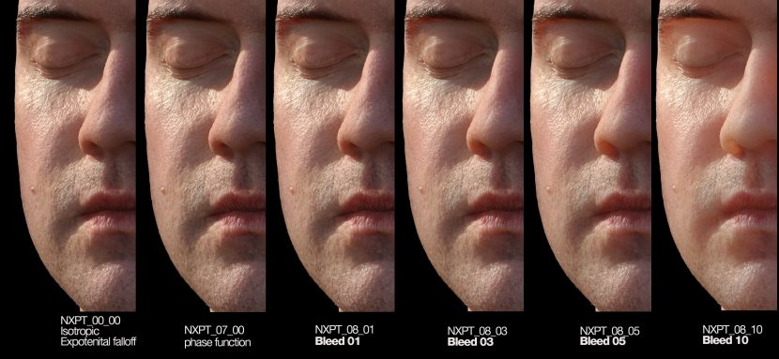
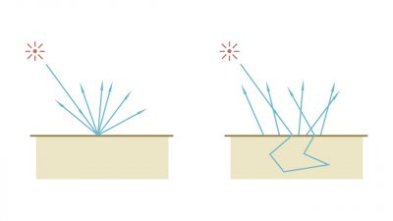
Subsurface scattering
https://www.fxguide.com/fxfeatured/pixar-deep-dive-on-sss-siggraph-preview/

Slide 15
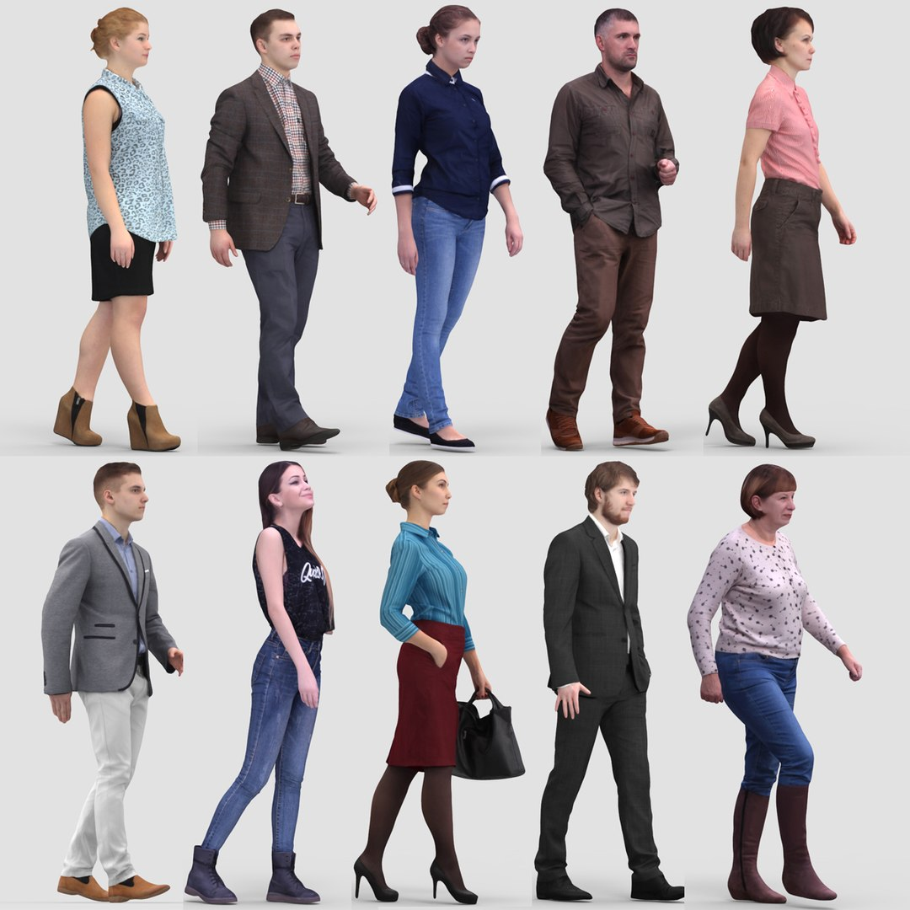
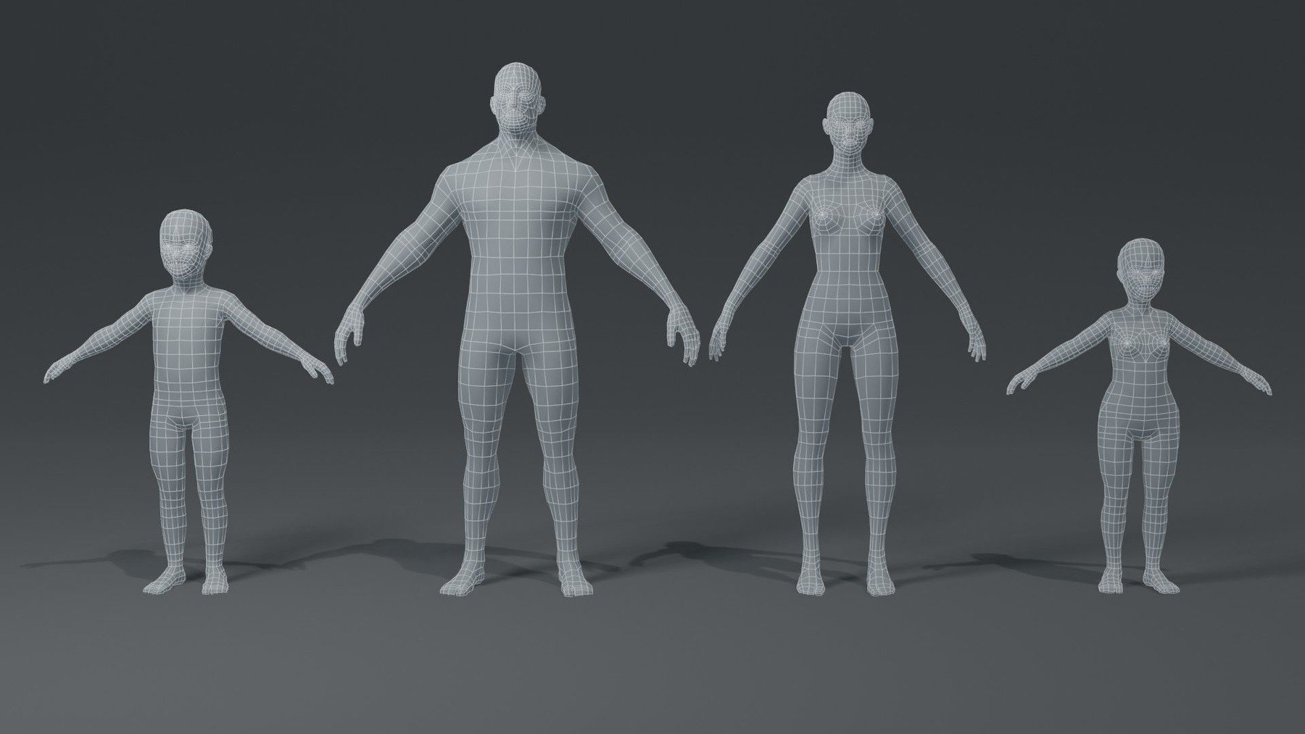
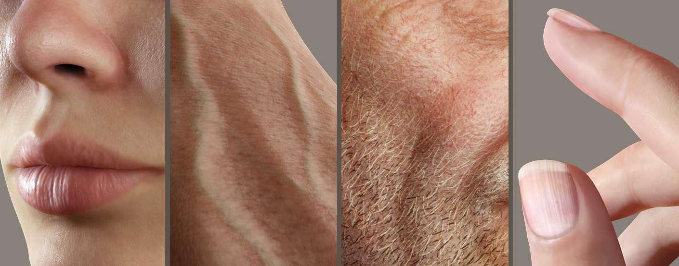
The pipeline
3D modeling
Appearance modeling
Rendering
- Points, Vertices
- Edges
- Meshes
- Reflectance modeling
- Texture generation
- Photo-realistic rendering
- Non photo-realistic rendering
Notes:
This is a general pipeline when developing applications in 3D computer graphics.
3 main processes – each one has its own research issues to be addressed
3D modeling – This process focuses on creating shape of 3D objects.
For example, here 3D models of digital humans in various sizes and shapes.
The components of this process are points or vertices and edges to form these models.
The human meshes are then constructed using defined vertices and edges.
Next, appearance modeling.
This is one of the key process to add and enhance realism to the final output images.
Basically, this process is to describe light interactions between the 3D model surfaces and the lighting.
For example, human skin is one of the most challenging surface to model.
Even lips, beard and nails, they are categorized as complex materials.
In real world, there are plenty of complex materials to be modeled for computer graphics problems.
The step to reproduce this light interactions of the surfaces is called reflectance modeling.
Lastly, rendering.
This process is to solve the light transport problem. It is focused on the equilibriums of photons in the rendered scenes.
In this process, it can be broadly categorized into photo-realistic and non-photo-realistic renderings.
To simplify this whole pipeline, we start from creating a 3d object and add its appearance by modeling the reflectance.
Then we solve how light travel in the scene to add various effects according to the lighting.

Slide 16
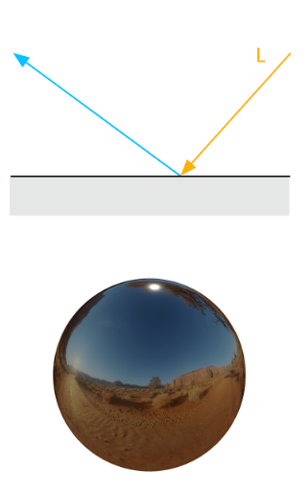
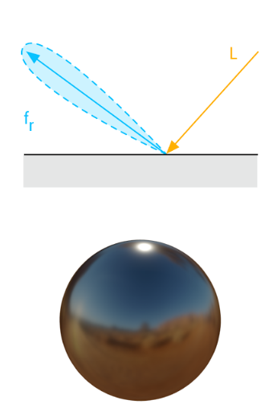
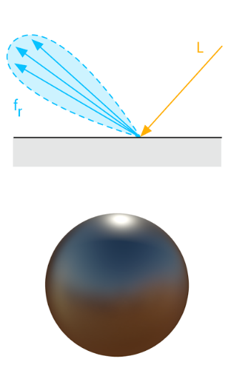
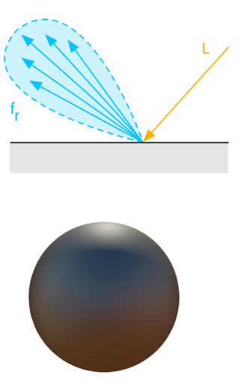
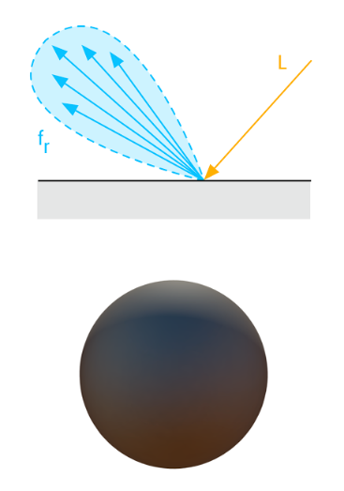
How to enhance realism ?
Surface scattering (Reflectance)
Romain Guy and Mathias Agopian, Physically Based Rendering in Filament, https://google.github.io/filament/Filament.html

Slide 17
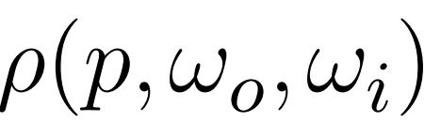



Reflectance - BRDF
Bidirectional Reflectance Distribution Function
describe surface appearance when light interacts with a surface.
BRDF is defined by light and viewing directions.

Slide 18
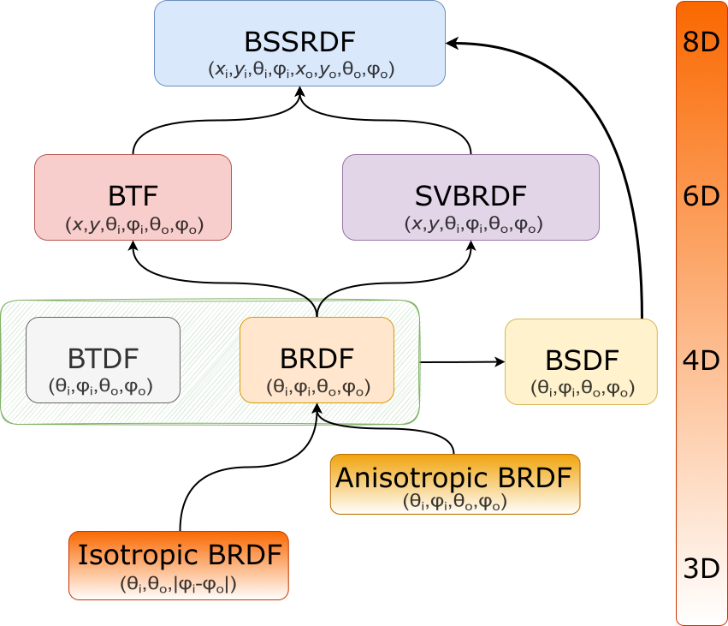

A taxonomy of reflectance functions

Slide 19
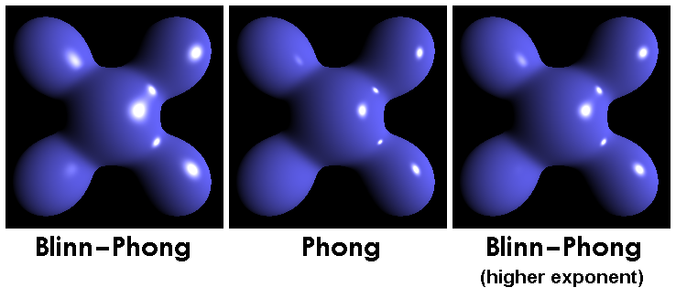
Empirical BRDFs
Lambertian
Phong
Blinn-Phong
Ward
Oren-Nayar
en.wikipedia.org/wiki/Blinn–Phong_reflection_model
Notes:
Show Blinn-Phong and Oren-Nayar models

Slide 20
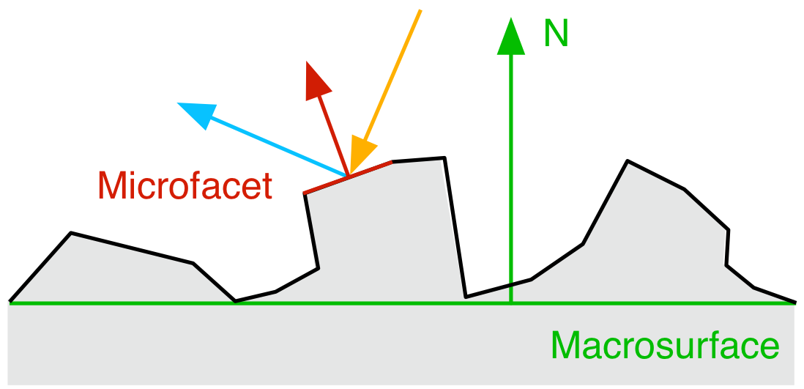
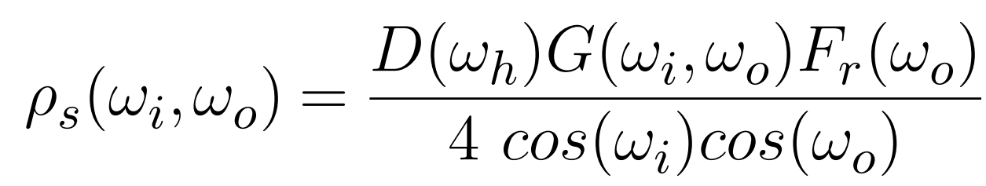
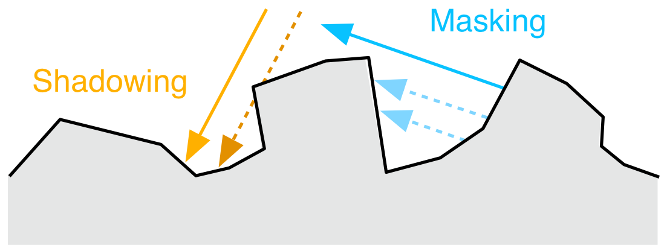
BRDF model – The analytical model
Analytical BRDF model
- The microfacet BRDF model
Romain Guy and Mathias Agopian, Physically Based Rendering in Filament, https://google.github.io/filament/Filament.html
Notes:
Describe each term

Slide 21
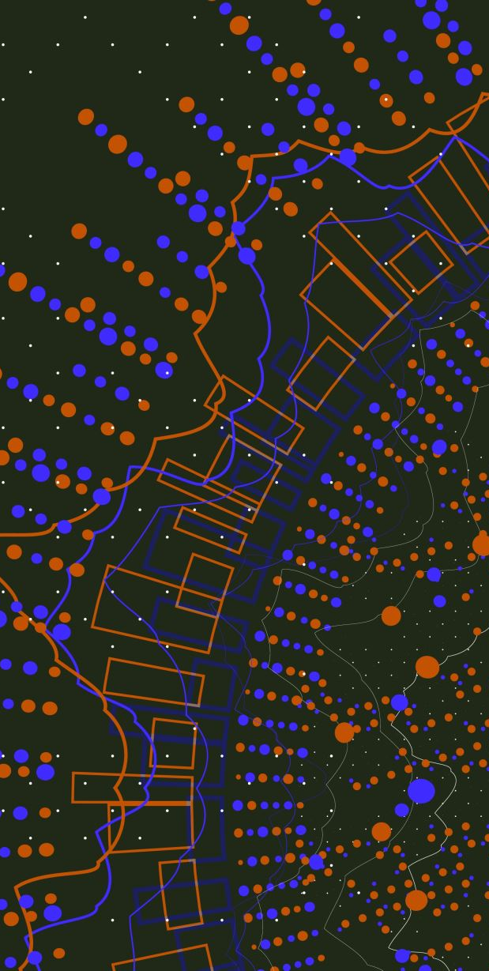
Light maps
A light map is a technique used to pre-calculate and store the brightness of surfaces in a virtual scene. This pre-calculated lighting information is then applied to the surfaces in real-time, significantly improving the visual quality of the scene while reducing the computational cost.

Slide 22
Light map processing
Pre-calculation
The scene is illuminated with virtual lights.
A specialized rendering process calculates how light interacts with each surface, considering factors like direct and indirect lighting, shadows, and reflections.
The resulting lighting information is stored in a texture map, called a lightmap.
Real-time Rendering
During gameplay or other real-time applications, the lightmap is applied to the surfaces of the scene.
This allows for realistic lighting effects, such as soft shadows, ambient occlusion, and global illumination, without the need for complex real-time calculations.
Notes:
Pre computation for light maps of the scene. → maps
Use light maps for real-time rendering. (only multiplications and additions required in this stage).

Slide 23
Light maps
Real-World Objects Have Multiple Materials
Objects like cars consist of various materials (e.g., shiny exteriors, reflective windows, matte tires, shiny rims), each with unique properties for ambient, diffuse, and specular lighting.
Limitations of Single Material System
Defining a single material for an entire object is not sufficient for complex models with multiple material types.
Diffuse and Specular Maps
To achieve more realistic material representation, diffuse maps and specular maps are introduced.
Diffuse maps control the diffuse and ambient colors, while specular maps control the precision of specular highlights for different parts of the object.
Notes:
Light maps = maps describe how light interact with surface = combinations of parameters related to light reflection.

Slide 24
Type of light maps
Diffuse map
Specular map
Normal map
Roughness map
Etc…
Notes:
It depends on the reflection model used in the shader (during rendering).

Slide 25
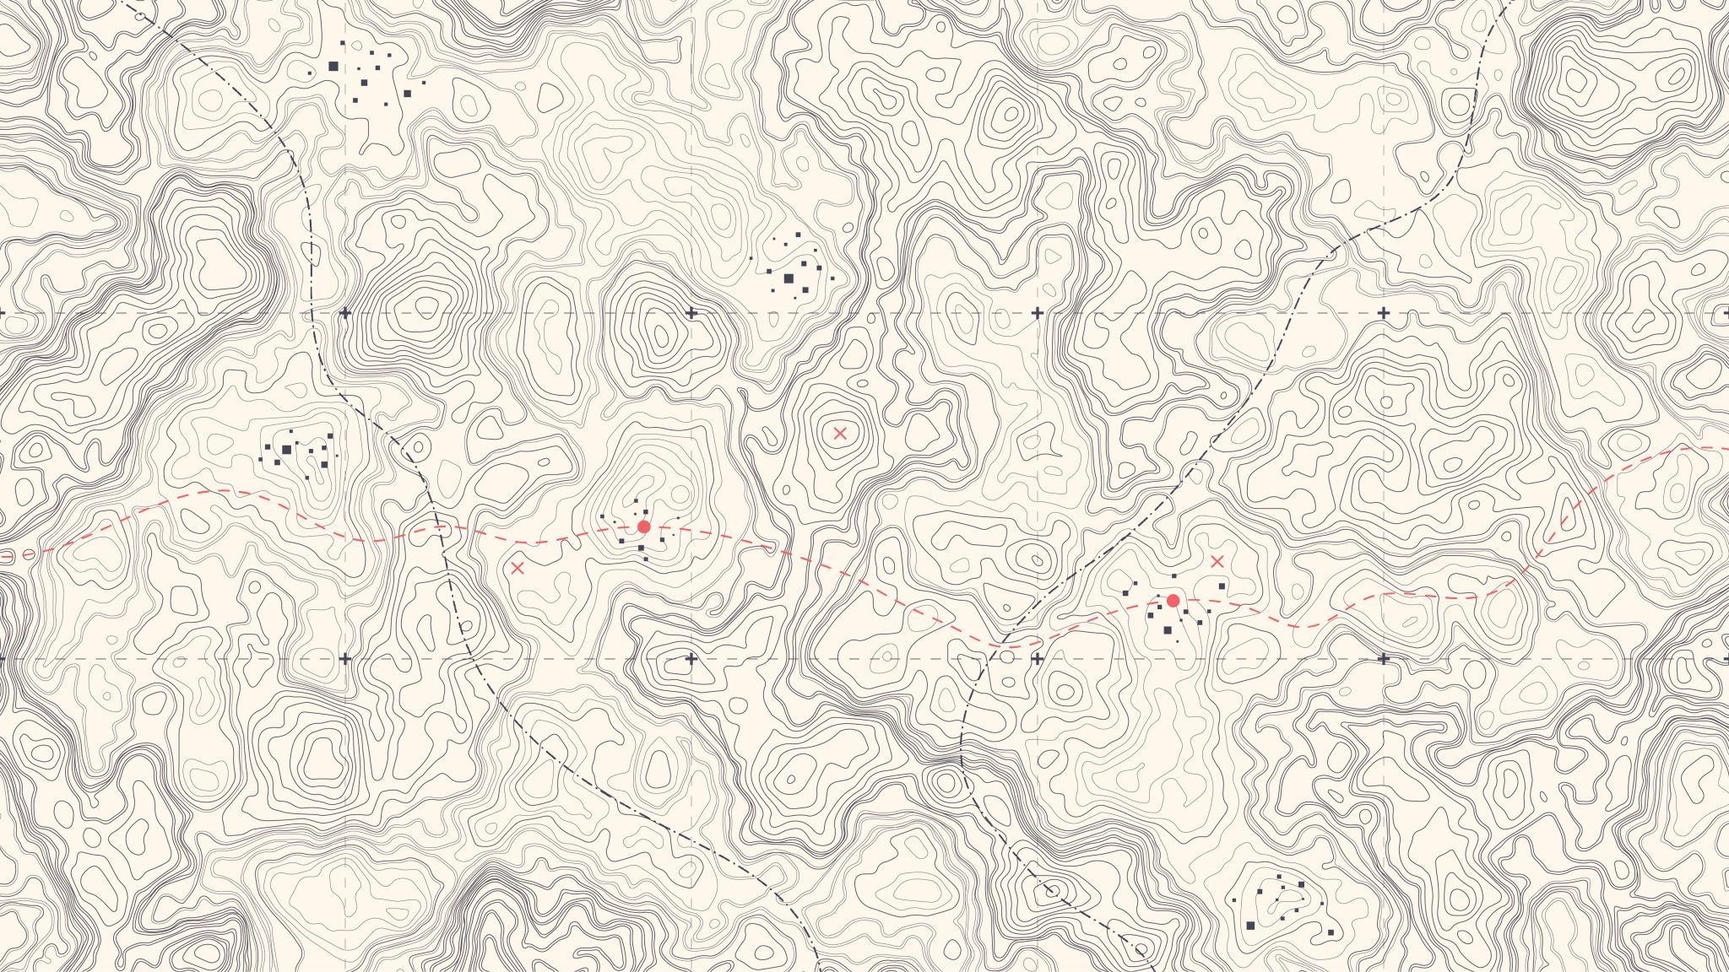
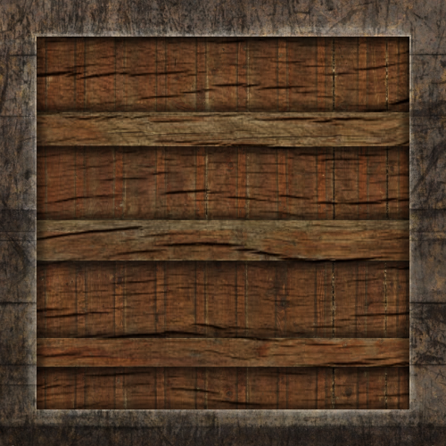
Diffuse map
What we want is some way to set the diffuse colors of an object for each individual fragment. Some sort of system where we can retrieve a color value based on the fragment's position on the object?
This should probably all sound familiar and we've been using such a system for a while now. This sounds just like textures we've extensively discussed in one of the earlier chapters and it basically is just that: a texture.
We're just using a different name for the same underlying principle: using an image wrapped around an object that we can index for unique color values per fragment.
In lit scenes this is usually called a diffuse map (this is generally how 3D artists call them before PBR) since a texture image represents all of the object's diffuse colors.

Slide 26
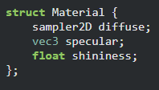
Change parameters to a texture (sampler2D)
Notes:
Instead of we have a diffuse color, we store diffuse colors as a texture.

Slide 27
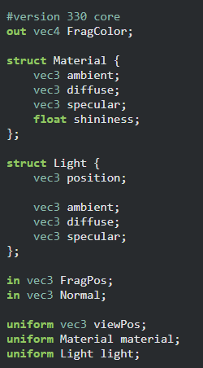
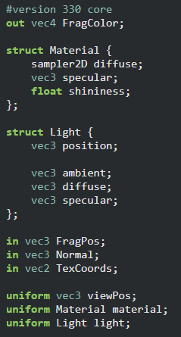
Minor changes
Diffuse map
Notes:
The fragment shader has some minor changes.

Slide 28
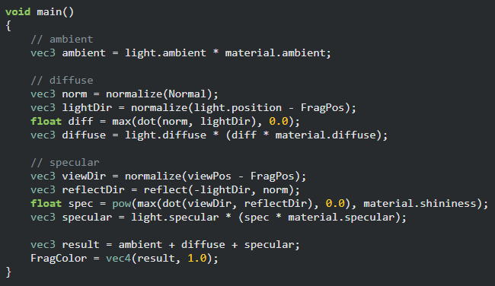
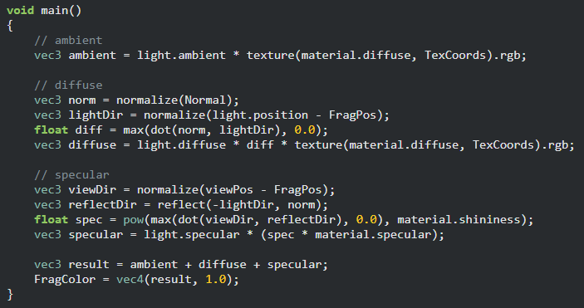
Replace with texture()
Diffuse map

Slide 29
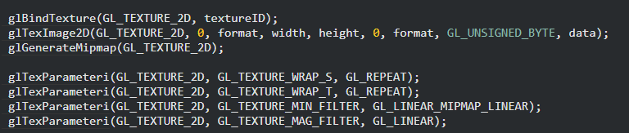
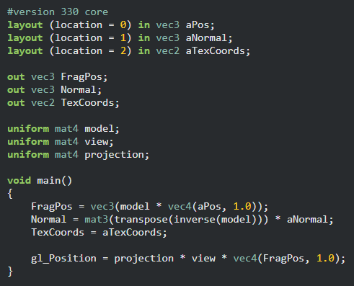
Binding texture and pass it to vertex and fragment shaders
Notes:
Since we make use of textures, we need to follow the steps of using texture.

Slide 30
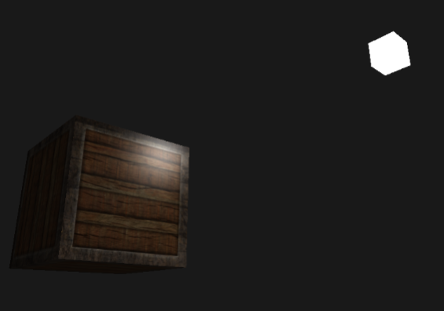
Result (Diffuse map)
Notes:
Note that this shader has specular component.
The wooden part is still reflecting specular color. → unrealistic?

Slide 31
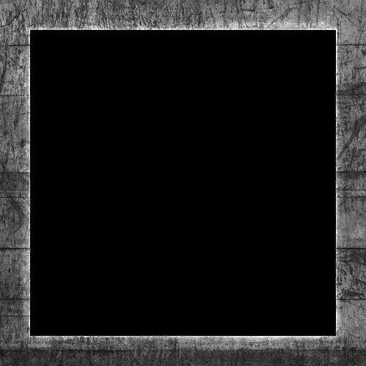
Specular map
Problem with Uniform Specular Highlights
Materials like wood typically don’t have specular highlights, while materials like steel do, but applying the same specular intensity across the entire object doesn’t look realistic.
Solution: Specular Maps
A specular map is a texture that defines specular intensities for different parts of the object, controlling where and how intense the highlights are.
Specular Map Representation
Specular maps are typically grayscale, where black represents no specular highlights (e.g., wood) and white or gray represents varying intensities of highlights (e.g., steel).
Shader Integration
In the fragment shader, the brightness of each pixel from the specular map is sampled and multiplied by the light's specular intensity, adjusting the highlight intensity based on the material.
Material-Specific Highlights
For materials like wood, specular intensities in the map are black, while steel borders show varying intensities based on surface details like cracks.

Slide 32
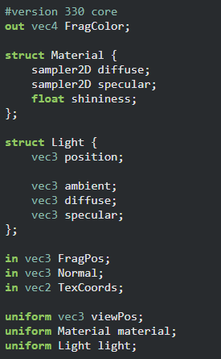
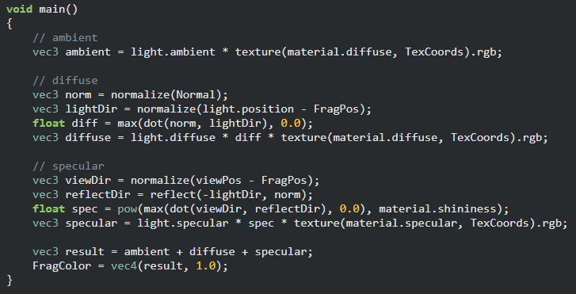
Fragment shader

Slide 33
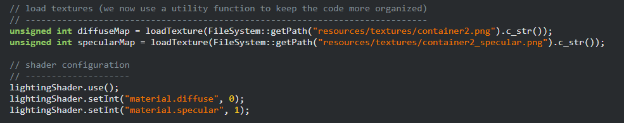
Load textures and set IDs accordingly

Slide 34
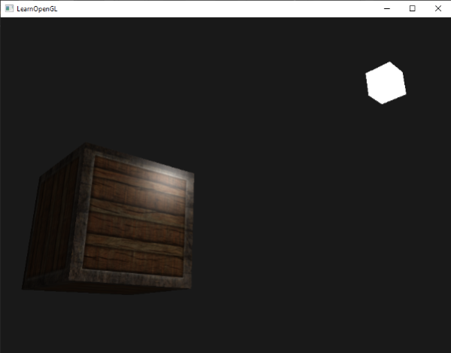
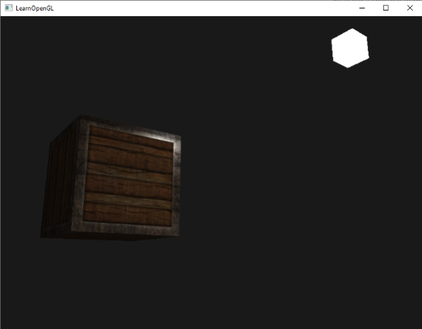
Spot the differences ?

